Slide 1
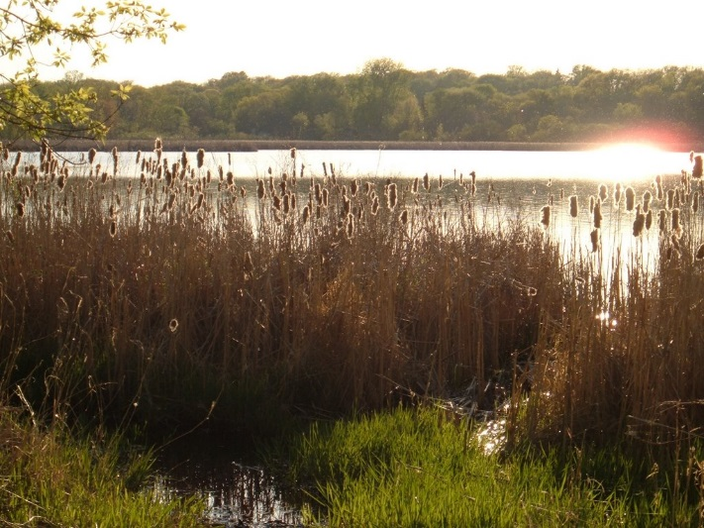
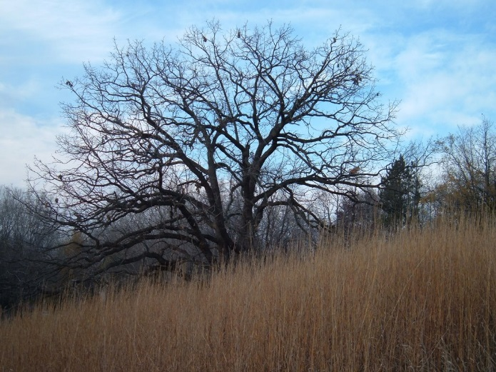
August 2018 Westwood Hills Nature Center Linear Stormwater Feature
Prepared for City of St. Louis Park

Slide 2
Project Location
Notes:
Westwood Hills Nature Center Project location

Slide 3
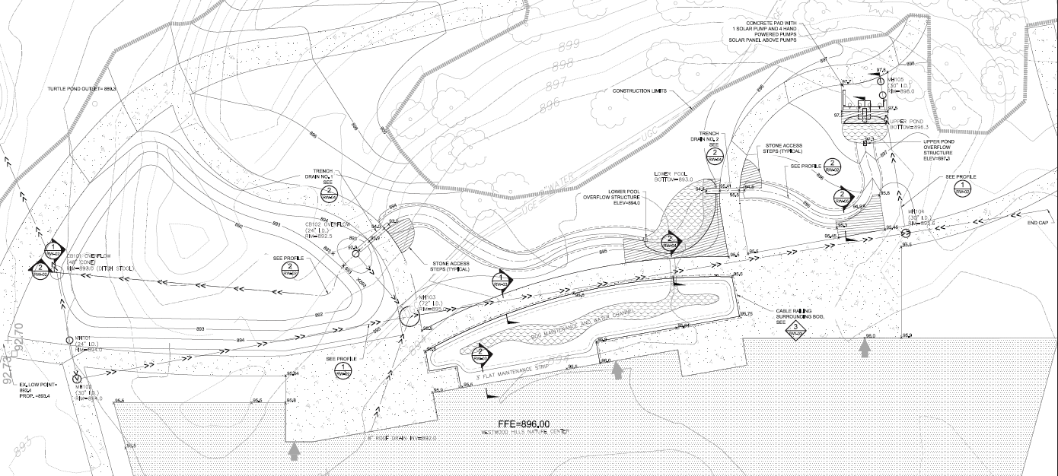
Plan View
Notes:
In general, the plan is consistent with 50% design. The pumping area was moved to allow for a bird watching area near the building windows.

Slide 4
Educational Opportunities
1
2
3
2
5
3
2
2
2
5
4
Pump Platform
Sidewalk crossings, Observation points
Emergent Vegetation
Bog
Channels – erosion, vegetation, infiltration
Notes:
Areas with educational opportunities

Slide 5
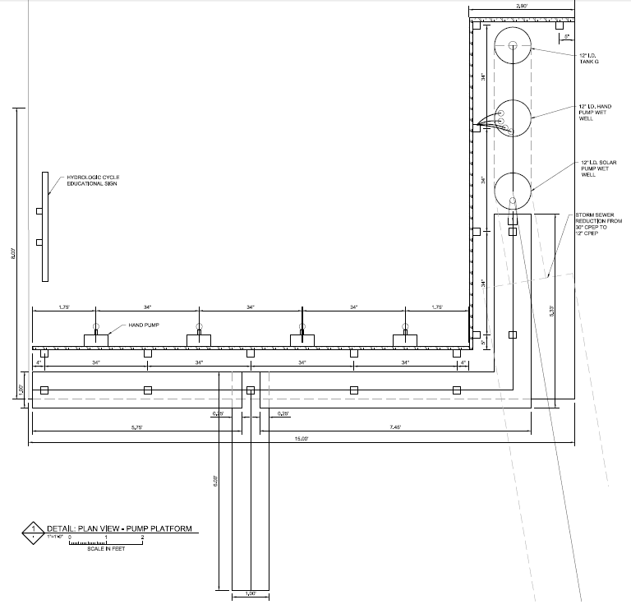
Pump Platform
Rain Gauge
Storage Gauge
Solar Powered Pump with Solar Panel Overhead
Hydrologic Cycle Sign
4 Hand Powered Pumps
Water Trough
Water discharge into upper pool
Notes:
4 hand powered pumps – the more energy put in, the more flow there is. Outflow mimics precipitation and runoff. Storage pipes mimic groundwater.
1 Solar pump with Solar Panel – relate how much water flows to how much the sun is shining. More sun=more energy=more flow.
Hydrologic Cycle Sign
Storage water level indicator or gauge shows how much water is in the “tank”, which can be related to how much it rained, or if we are in a drought period.
Rain Gauge will be mounted along the rail. Other weather related equipment could be mounted as well – a wind vane and/or anemometer, thermometer, barometer. Compass.

Slide 6
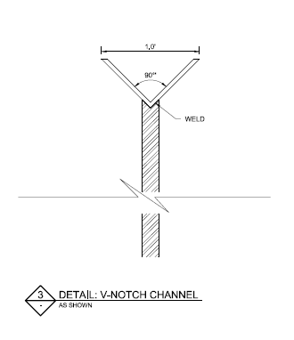
Pump Platform Sections
Notes:
More detailed view of the hand pump and trough that will drop into the upper pond.

Slide 7
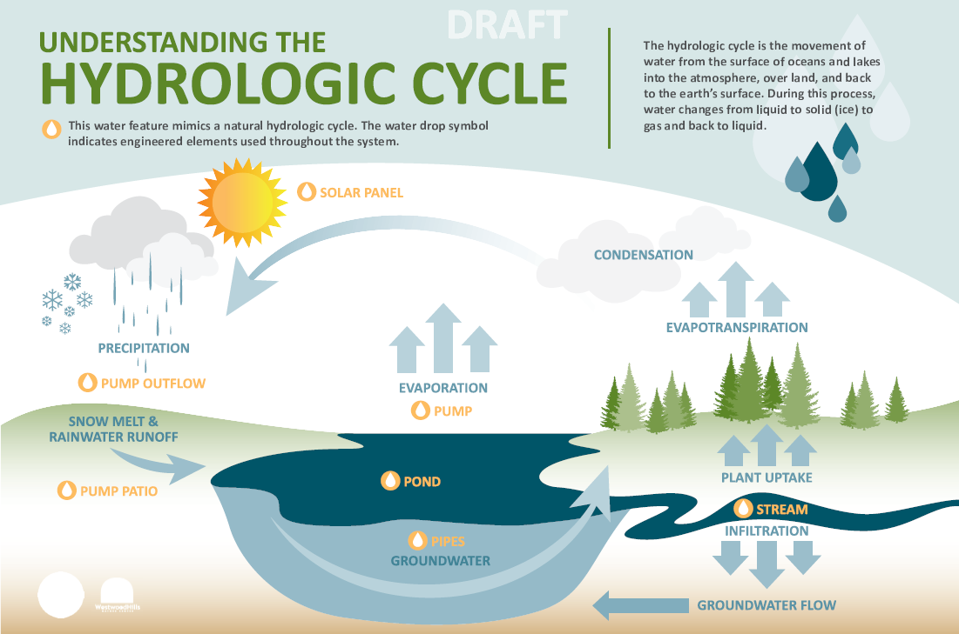
Notes:
Sign will show how the system mimics the hydrologic cycle. City can develop curriculum around the hydrologic cycle.

Slide 8
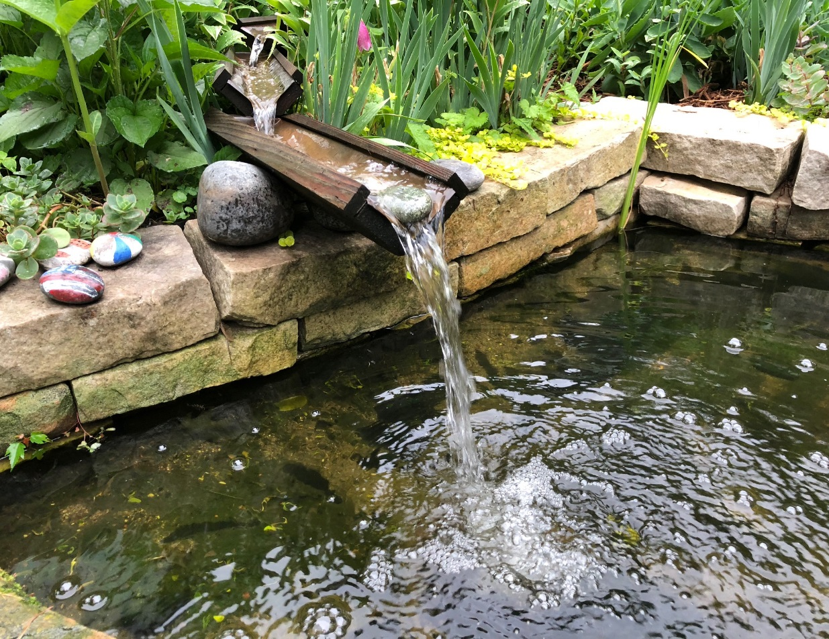
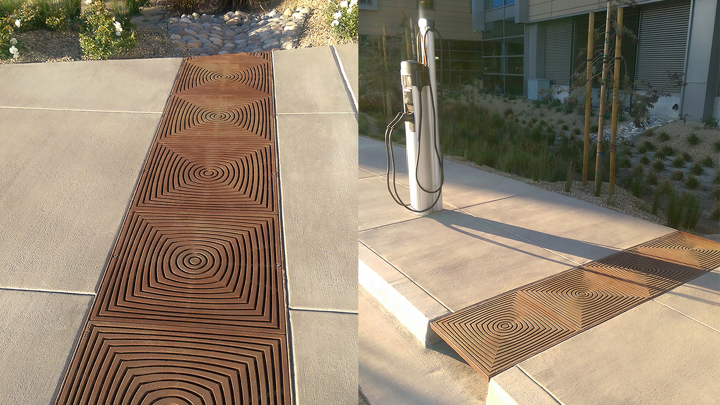
Sidewalk Crossings and Flow into Pool
Notes:
2 walk crossings with extended vee-shape flow
1 walk crossing at bog

Slide 9
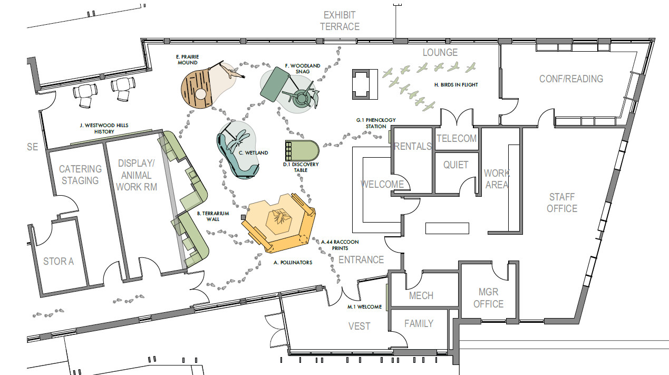
Exhibits inside building
All work shown is by HGA and Split Rock Studios
Notes:
Show this slide to show what type of exhibits are inside which go well with the bog outside.

Slide 10
Exhibits inside building
All work shown is by HGA and Split Rock Studios
Notes:
Wetland exhibit can point outside to the bog.

Slide 11
Notes:
Bog Sign – Bogs important for habitat, great at sequestering carbon. Often used as a soil amendment for organic matter. Has been used as a heat source in other locations, particularly in Ireland. Peat bogs are threatened by development, climate change, and over use for soil amendments. This will help people understand them. Curriculum will be developed around bogs by city staff.

Slide 12
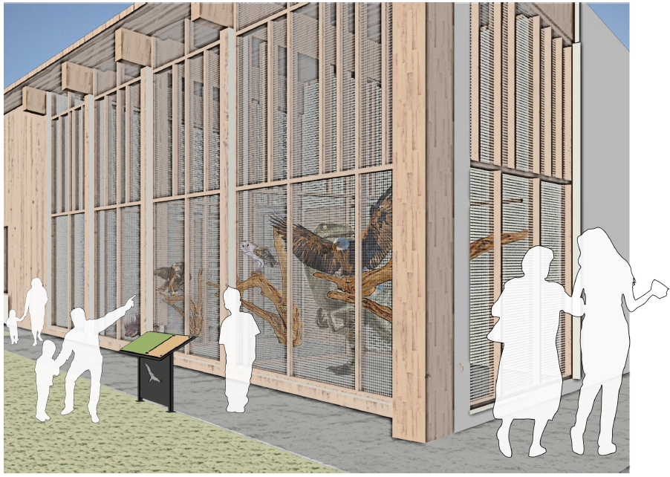
Raptor Sign (bog sign will be similar)
All work shown is by HGA and Split Rock Studios
Notes:
Bog Sign will be similar in size and materials to the raptor sign.

Slide 13
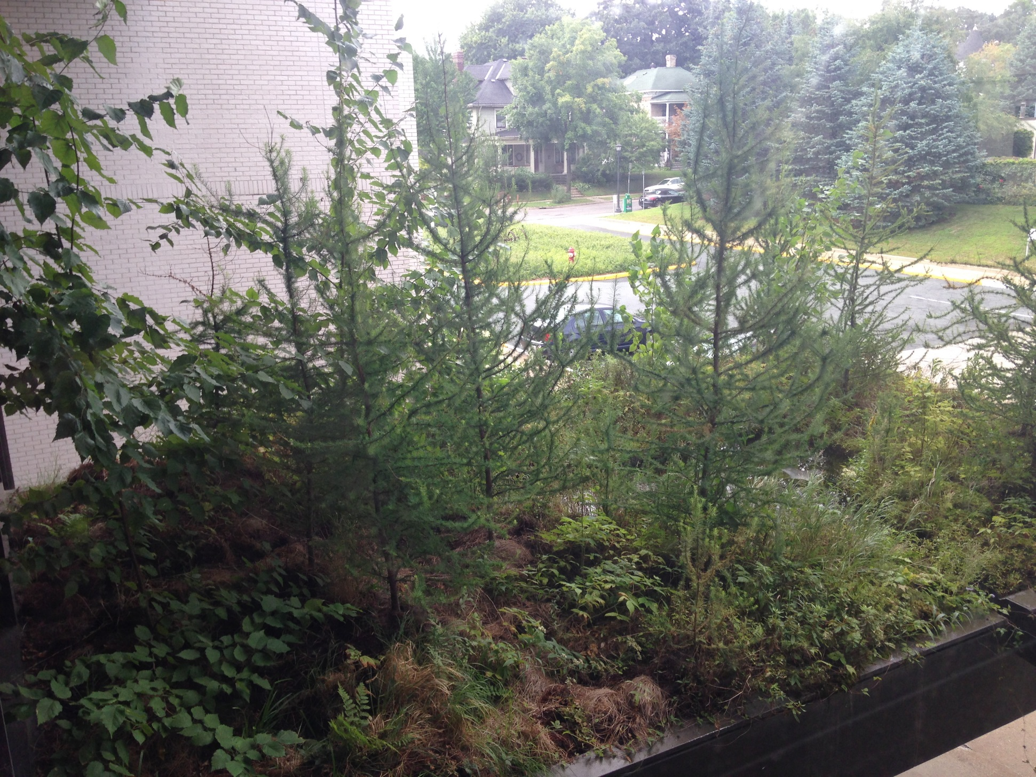
Rooftop Bog at MCAD in Minneapolis
Notes:
Bog plants during summer.

Slide 14
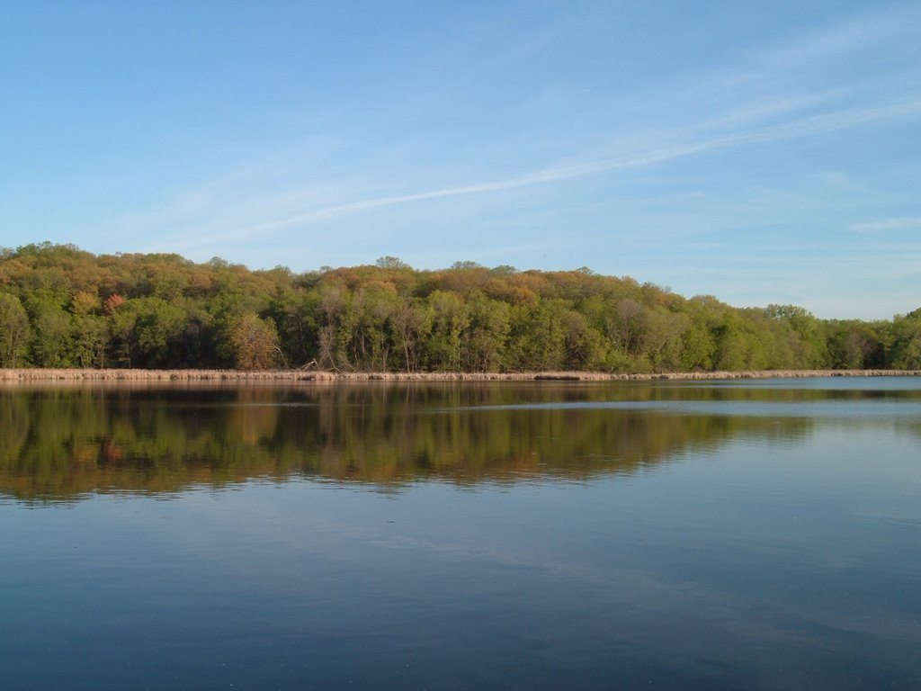
questions

Slide 15
Wetland Exhibit Sign inside building
All work shown is by HGA and Split Rock Studios

Slide 16
Peat bog
Notes:
Cross section of the bog

Slide 17
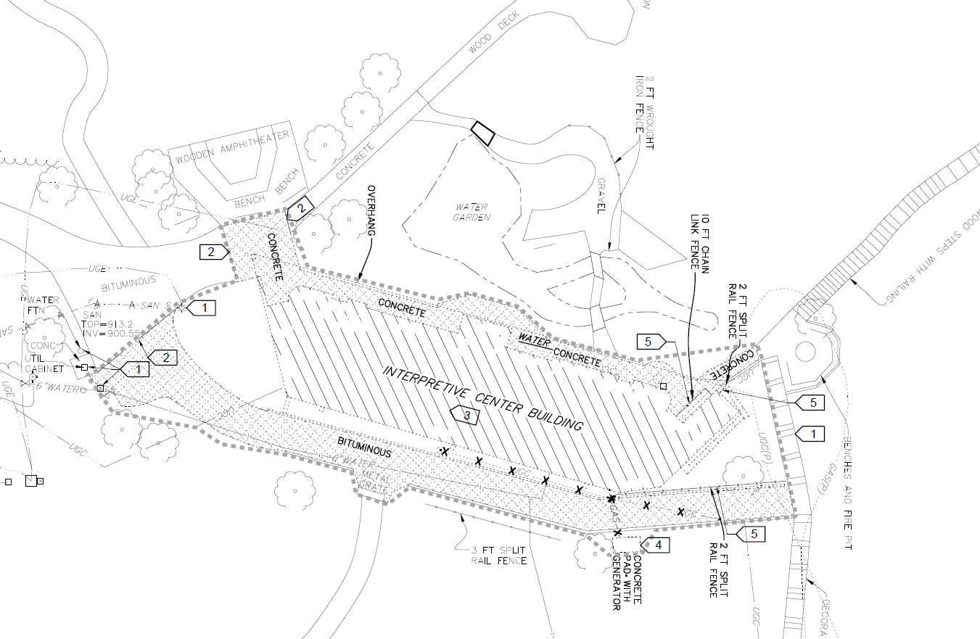
Existing WHNC Building (plan by HGA)

Slide 18
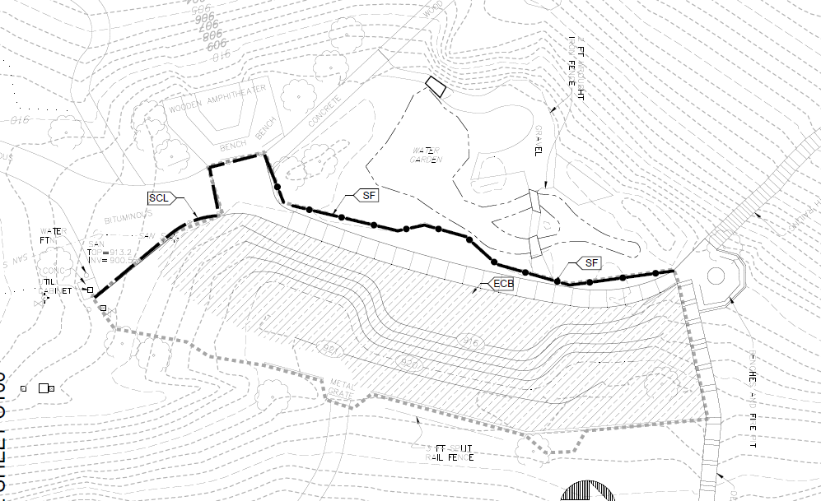
Proposed Outdoor Classroom (plan by HGA)

Slide 19
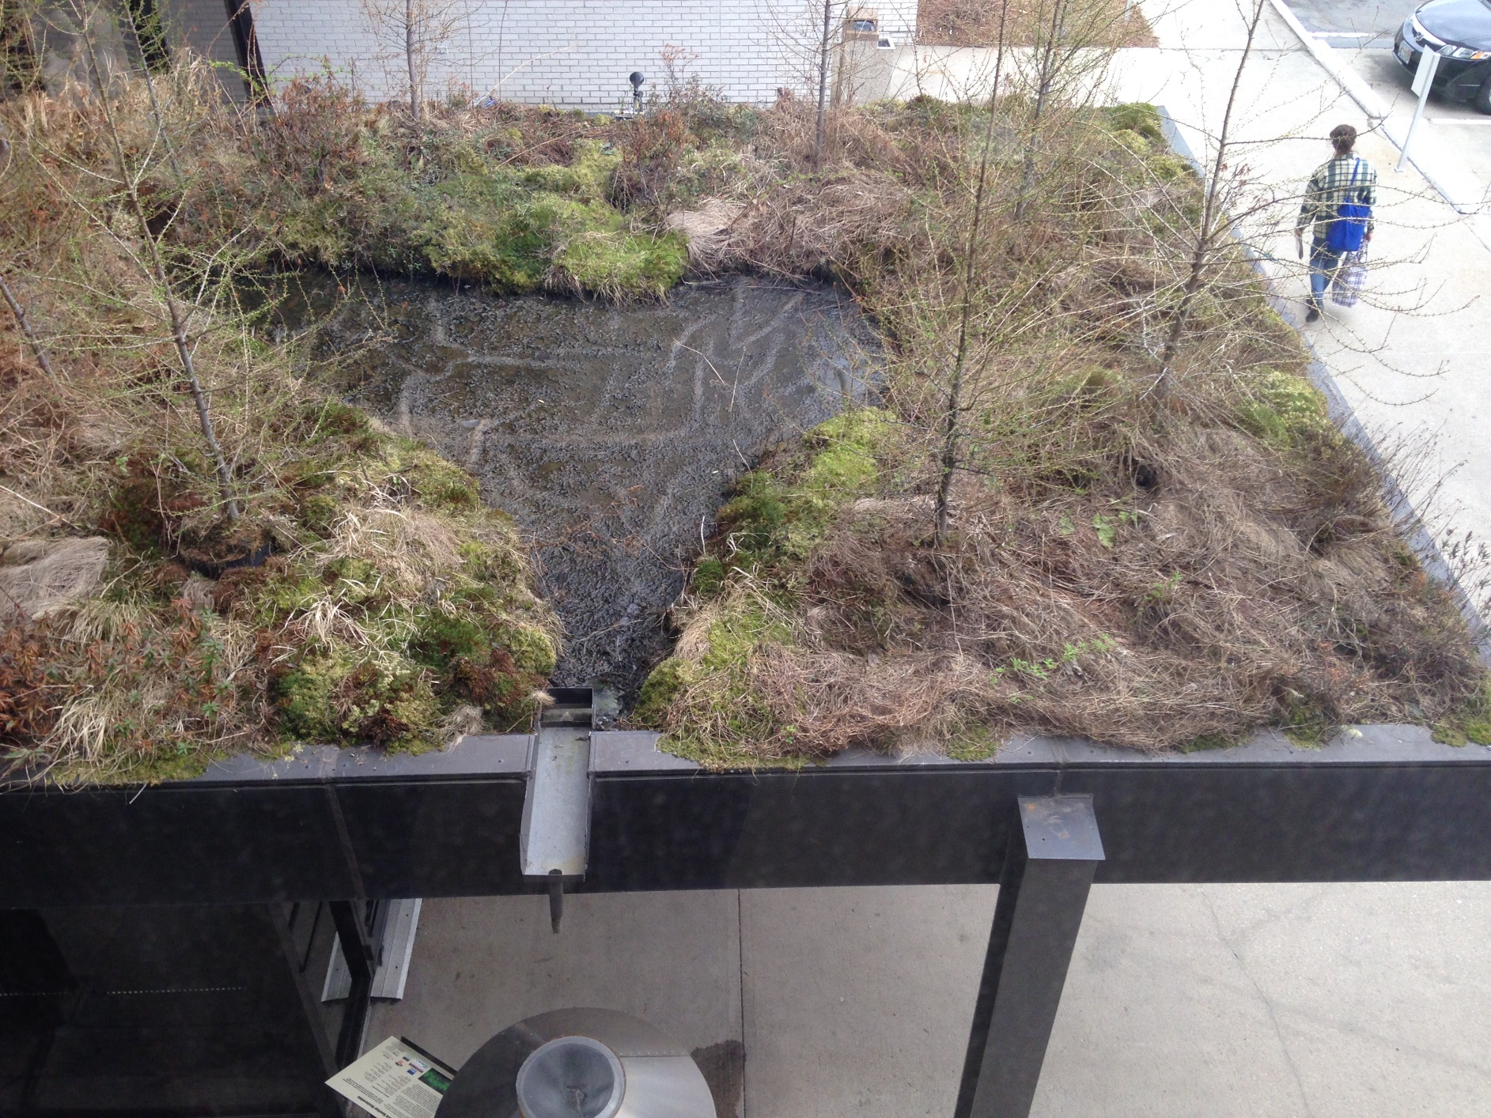
Rooftop Bog at MCAD in Minneapolis
Notes:
Bog plants dormant. Water area in center is to assess water level and for easy maintenance. Maintenance personnel can walk in the water to maintain all surrounding plant areas.

