Slide 1
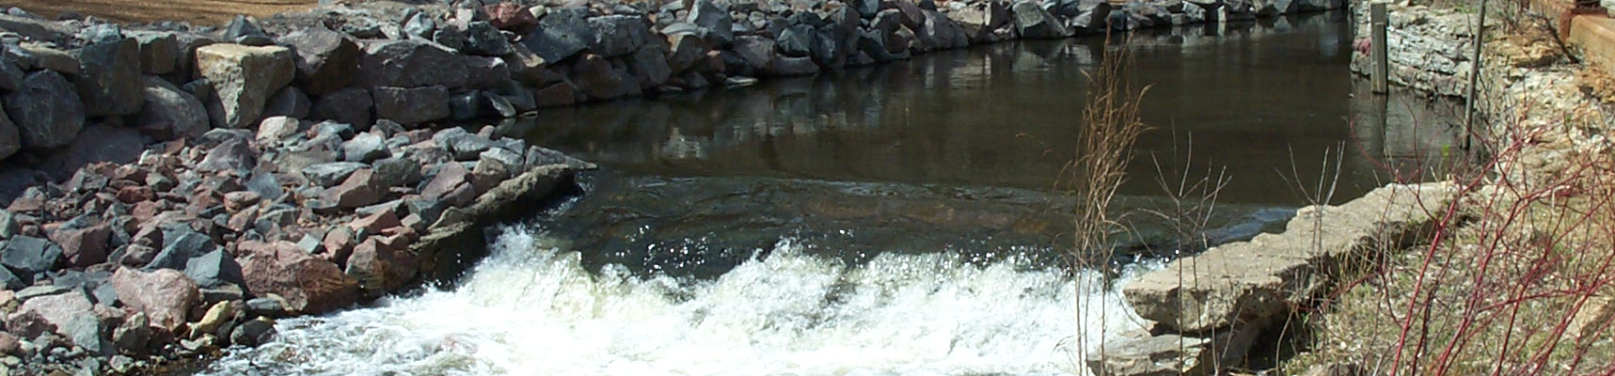
Bassett Creek Chloride Assessment
June 15, 2017 Presentation
Greg Wilson
Barr Engineering Company

Slide 2
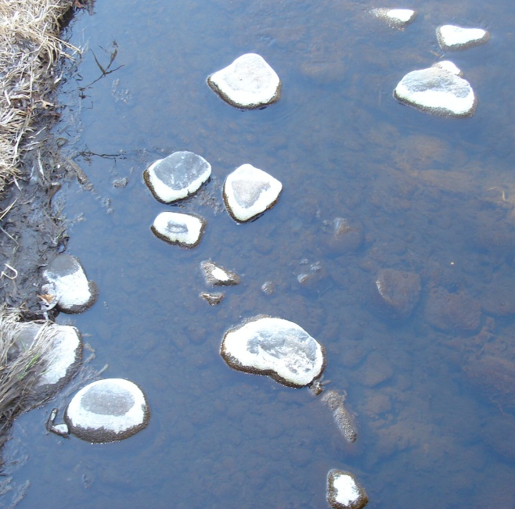

Overview
Chloride
  What is it?
  How does it affect creeks and lakes?
Water quality impairments
Monitoring results
  Comparisons with water quality standards; trends
  Snowmelt/spring runoff monitoring—watershed-wide
Salt diet ↔ Total Maximum Daily Load (TMDL)
  How do current sources contribute to impairment?
  Determines assimilation capacity; management strategies

Slide 3

What is chloride? Where does it come from?
Chloride occurs naturally in water
  Dissolution of soil, rock and mineral formations
Significant component of most deicers and water softeners
  Sodium chloride
  Magnesium chloride
  Calcium chloride
Component of some fertilizers, dust suppressants and industrial process waters
Chloride stays in solution, travels with water flow
  Roads, parking lots, driveways, sidewalks and salt storage
  There are no treatments, only source control

Slide 4
Adverse surface water impacts of chloride
High levels of chloride are toxic to sensitive organisms
  Fish
  Invertebrates
  Plants
  Soil quality, pets/wildlife
Disrupts natural lake mixing
  Leads to lower dissolved oxygen in bottom waters and associated impacts on benthic organisms and nutrient cycling
Drinking water supplies—human health concerns

Slide 5
Road salt dilemma
Chloride-containing deicers are almost exclusively being relied on for public safety
  Use has gone up significantly in recent past
  No economic alternative without negative impacts on the environment
  Increasing trends in surface and groundwater concentrations, especially in more developed portions of Twin City Metro Area
  About 74% of applied chloride is retained in the watershed
  Infrastructure/vehicle corrosion

Slide 6
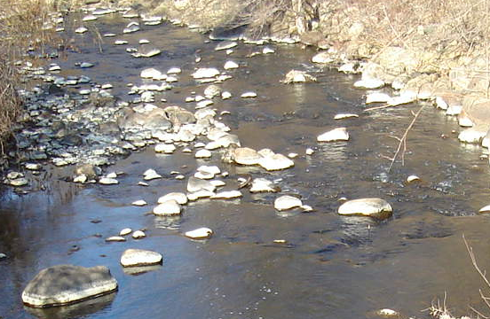
Chloride impairments—lakes and streams
230 mg/L chronic standard (four-day average), no more than one sample exceedance within 3-year period
860 mg/L maximum standard, once in 3 years

Slide 7
Bassett Creek watershed chloride impairments—lakes and streams
Bassett Creek
Plymouth Creek
Parkers Lake
Spring Lake ↑
Sweeney Lake
Wirth Lake ↑
Medicine Lake “high risk water”

Slide 8
Median Annual Chloride Levels for Some Metro Streams
Source: Met Council
Notes:
2003-2012 flow-weighted median concentrations—Bassett has highest annual flow-weighted mean chloride concentration (139 mg/L) in MCES monitoring network.

Slide 9
Average Annual Chloride Yield for Some Metro Streams
Source: Met Council
Notes:
2003-2012 annual chloride yield

Slide 10
Chloride Trend for Bassett Creek
Source: Met Council
Notes:
2003-2012 annual chloride yield

Slide 11
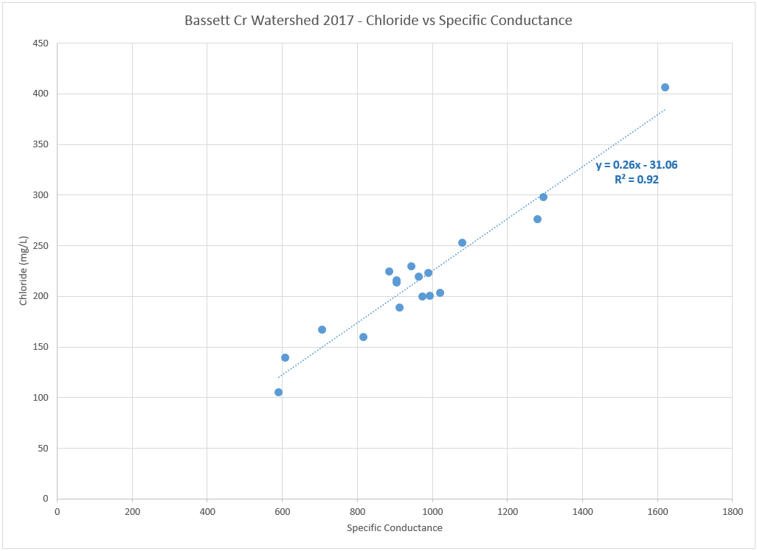
Chloride & Conductivity monitoring
230 mg/L

Slide 12
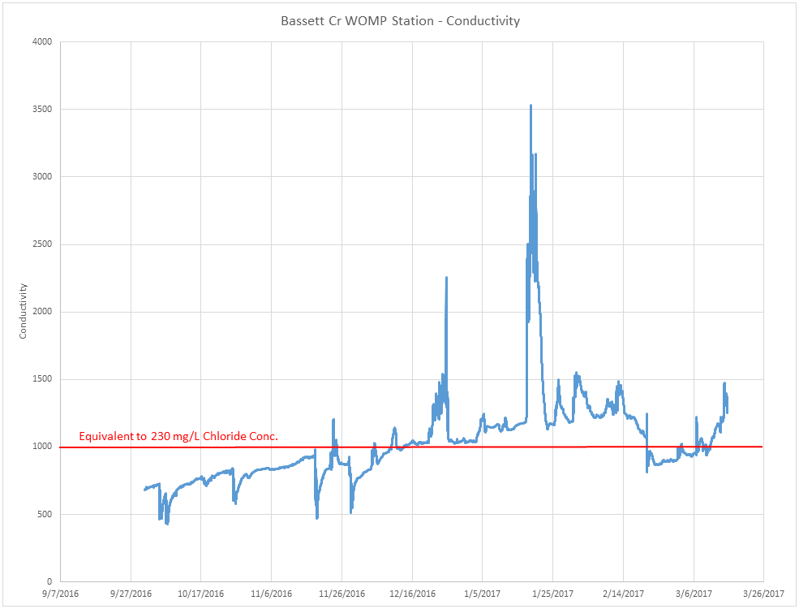
Chloride & Conductivity monitoring
Feb. 20-21st
Notes:
conductivity reading of 3739 associated with acute chloride standard

Slide 15
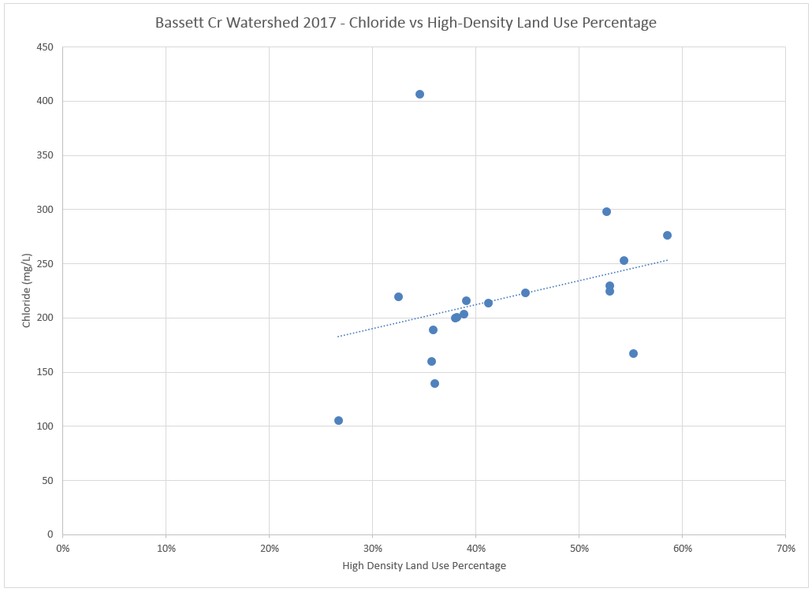
Relationship Between Chloride Levels and Higher-Density Land Uses
Notes:
2003-2012 flow-weighted median concentrations

Slide 16
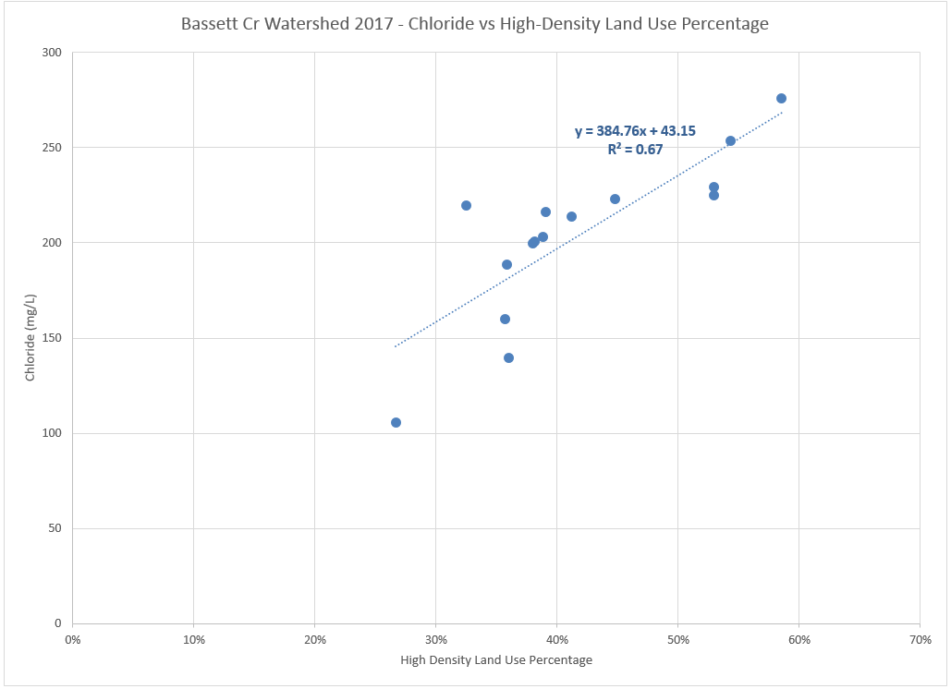
Relationship Between Chloride Levels and Higher-Density Land Uses
Notes:
2003-2012 flow-weighted median concentrations; it is expected that these concentrations could have ranged from 280 to 760 mg/L during the January low-flow period

Slide 17
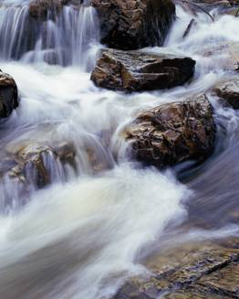
TMDL formula determines our salt diet
…or the maximum amount of chloride that can be discharged to a waterbody and still meet water quality standards

Slide 18
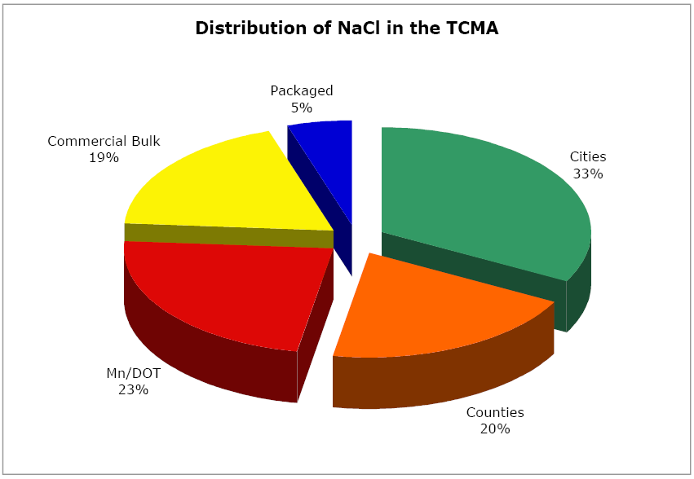
Existing road salt application rates
Using SAFL data for salt applications and BCWMC/ TCMA proportional land uses
  Overall percentage of higher-density land uses in Bassett Creek watershed is 4.7 times the percentage in TCMA
  Affects commercial bulk and packaged estimates
Total Twin City Metro Area (TCMA) salt application estimates from St. Anthony Falls Laboratory (SAFL) study (Sander et al., 2007)

Slide 19
Allowable contributions/implementation strategies
For TMDLs to be achieved, it will require significant reductions of chloride load and implementation of several management strategies:
  Management of road salt inputs from both road authorities and commercial and private applicators
  Education and training
  Equipment upgrades

Slide 20
Questions??

